Slide 1
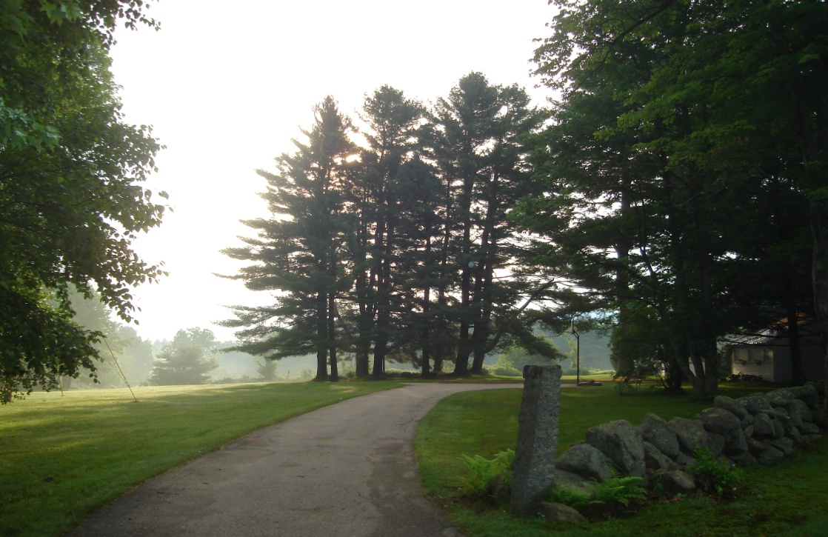
Forest Watch to Forest Watch
Building
on a
Great Idea
Presentation for
Forest Watch teachers,
UNH, March 2009
Martha Carlson.

Slide 2
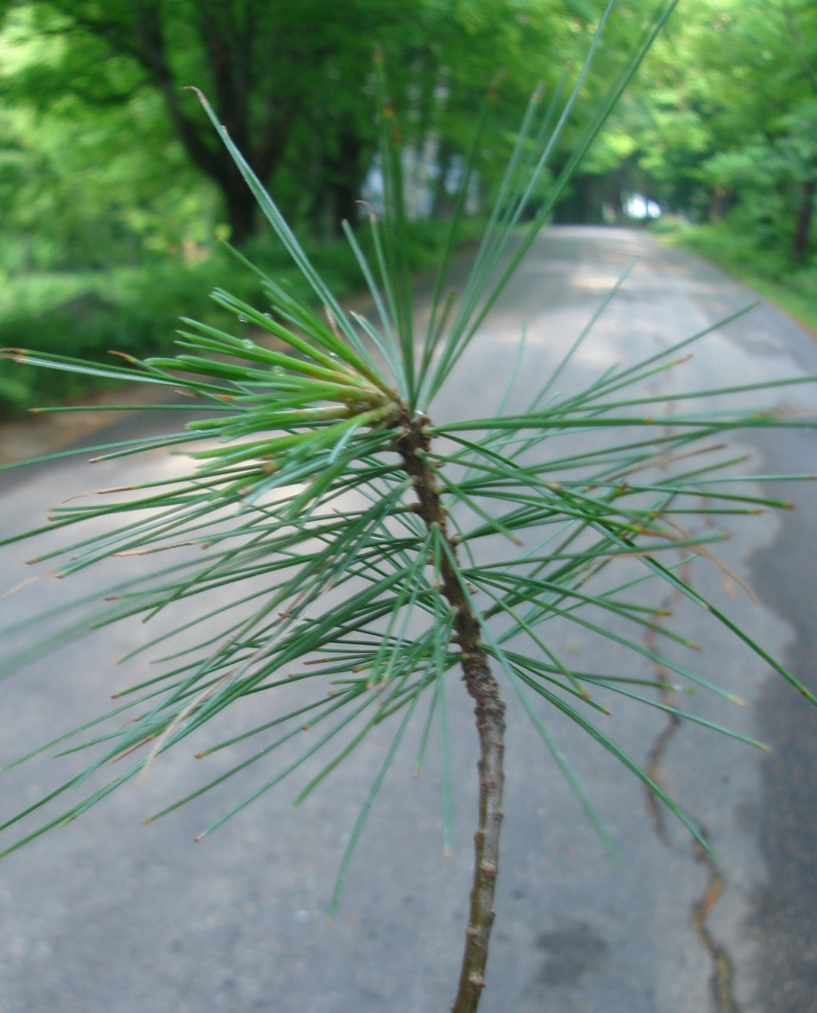
Forest Watch studies gives teachers and students:
Exposure to academic
challenges:
Botany
Math
Statistics
Physics
Satellite imagery
Calculus
Social studies
Comparative Forestry
Art and Literature

Slide 3
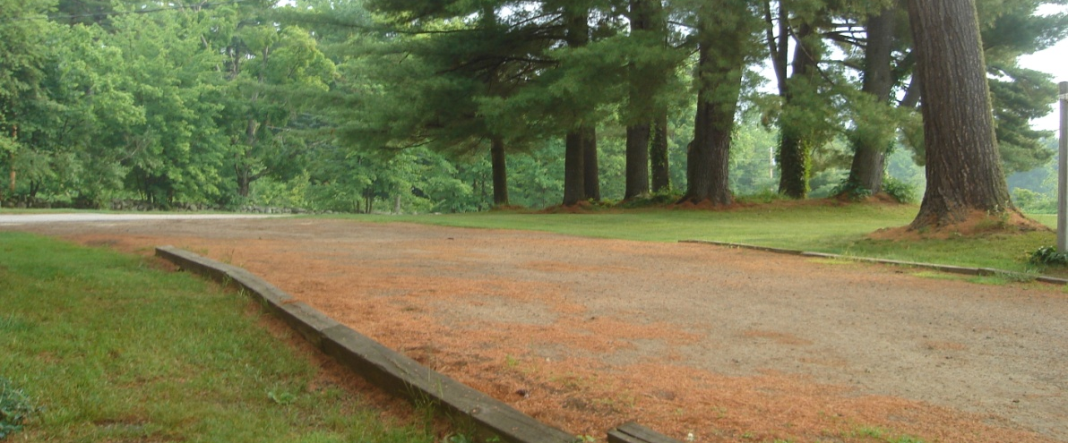
New perspectives on
The size of the air pollution issue
The size of the organism affected
The power of students
The power of long-term studies
The power of analysis
The limits of knowledge
Daily change in the environment

Slide 4
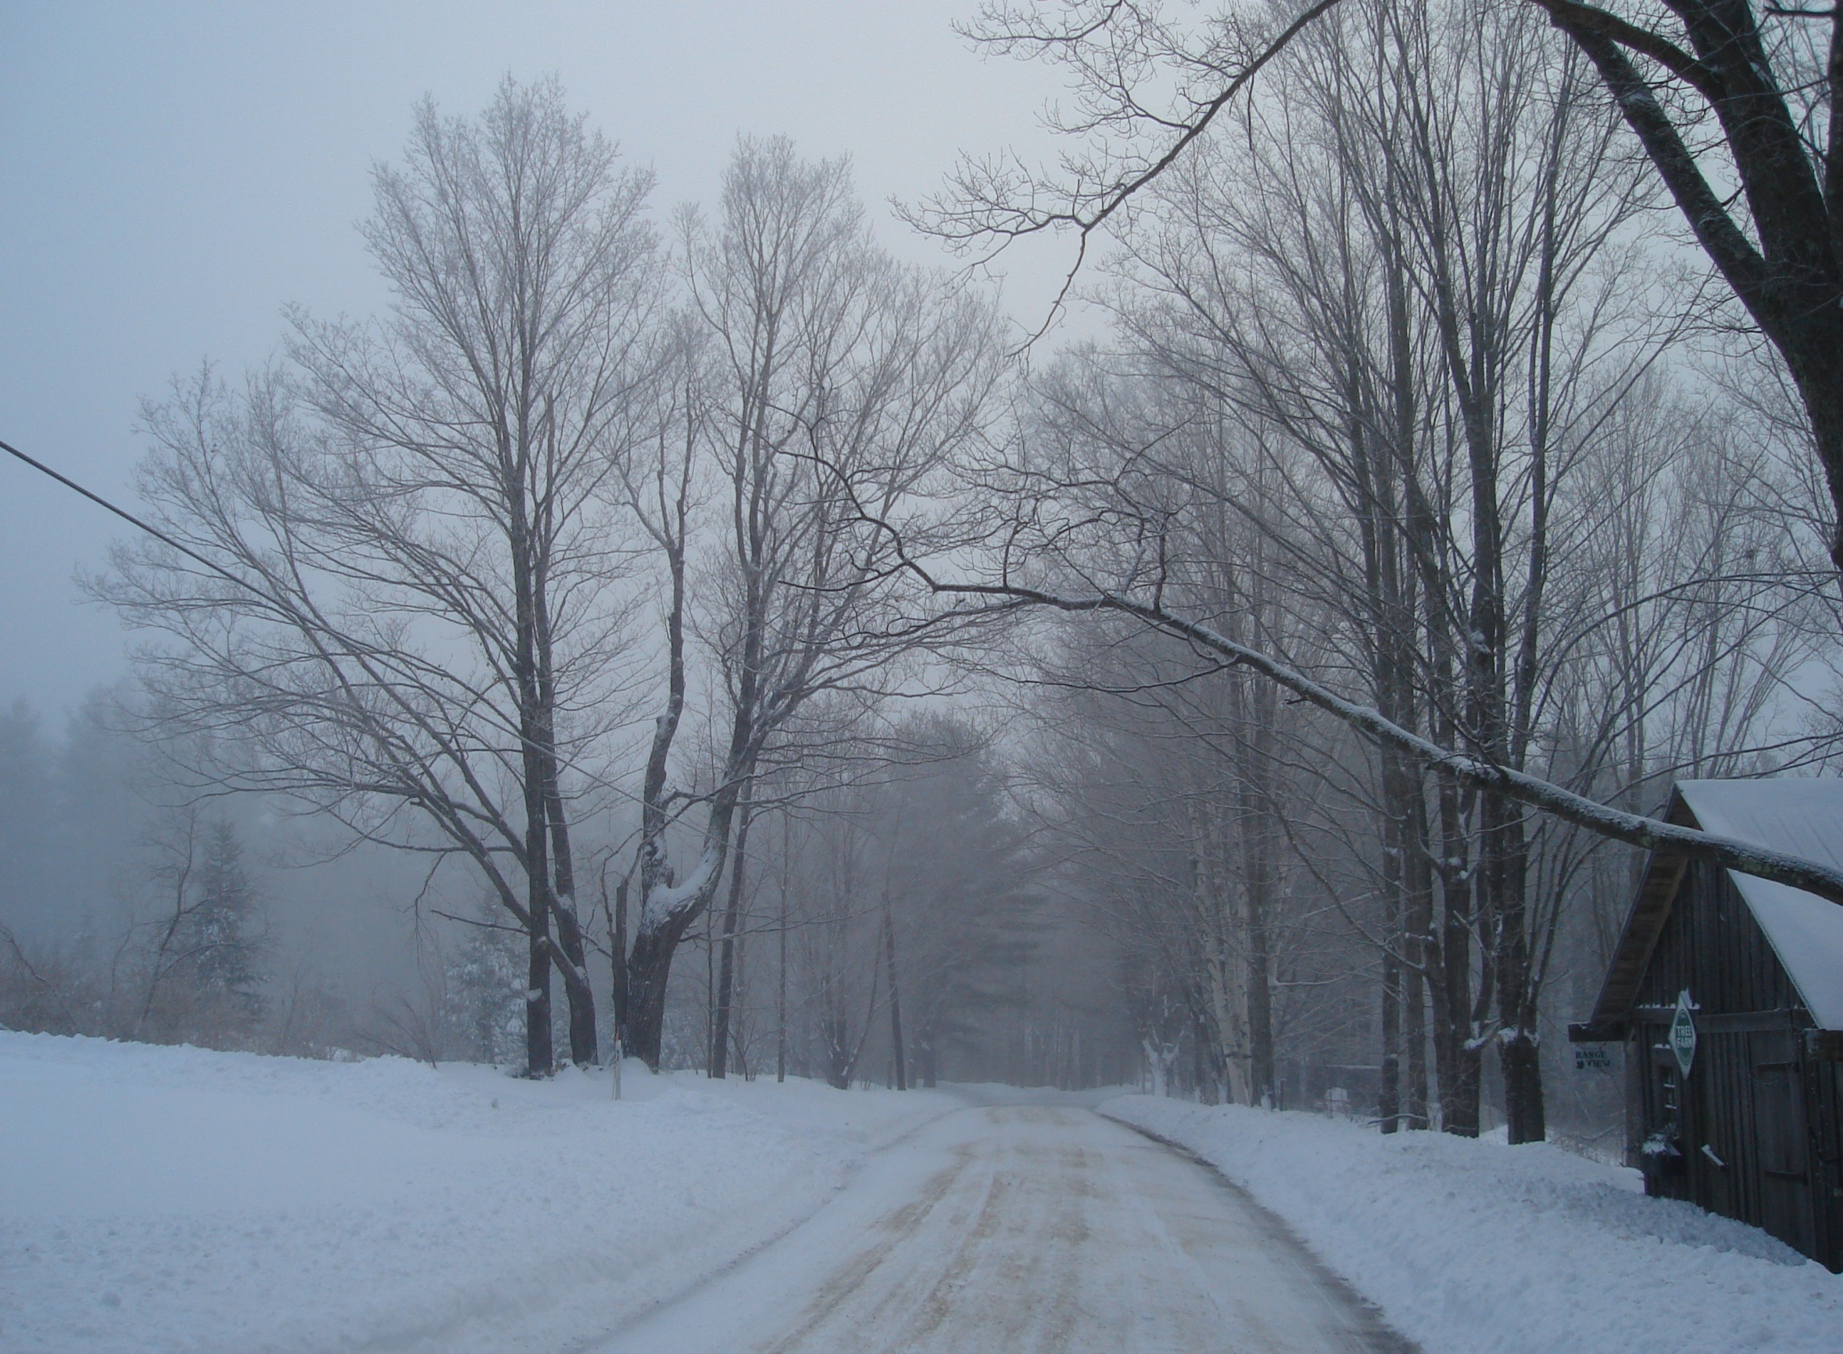
Acer saccharum, Sugar Maple
Farewell to New England’s Sweetest Tree?

Slide 5
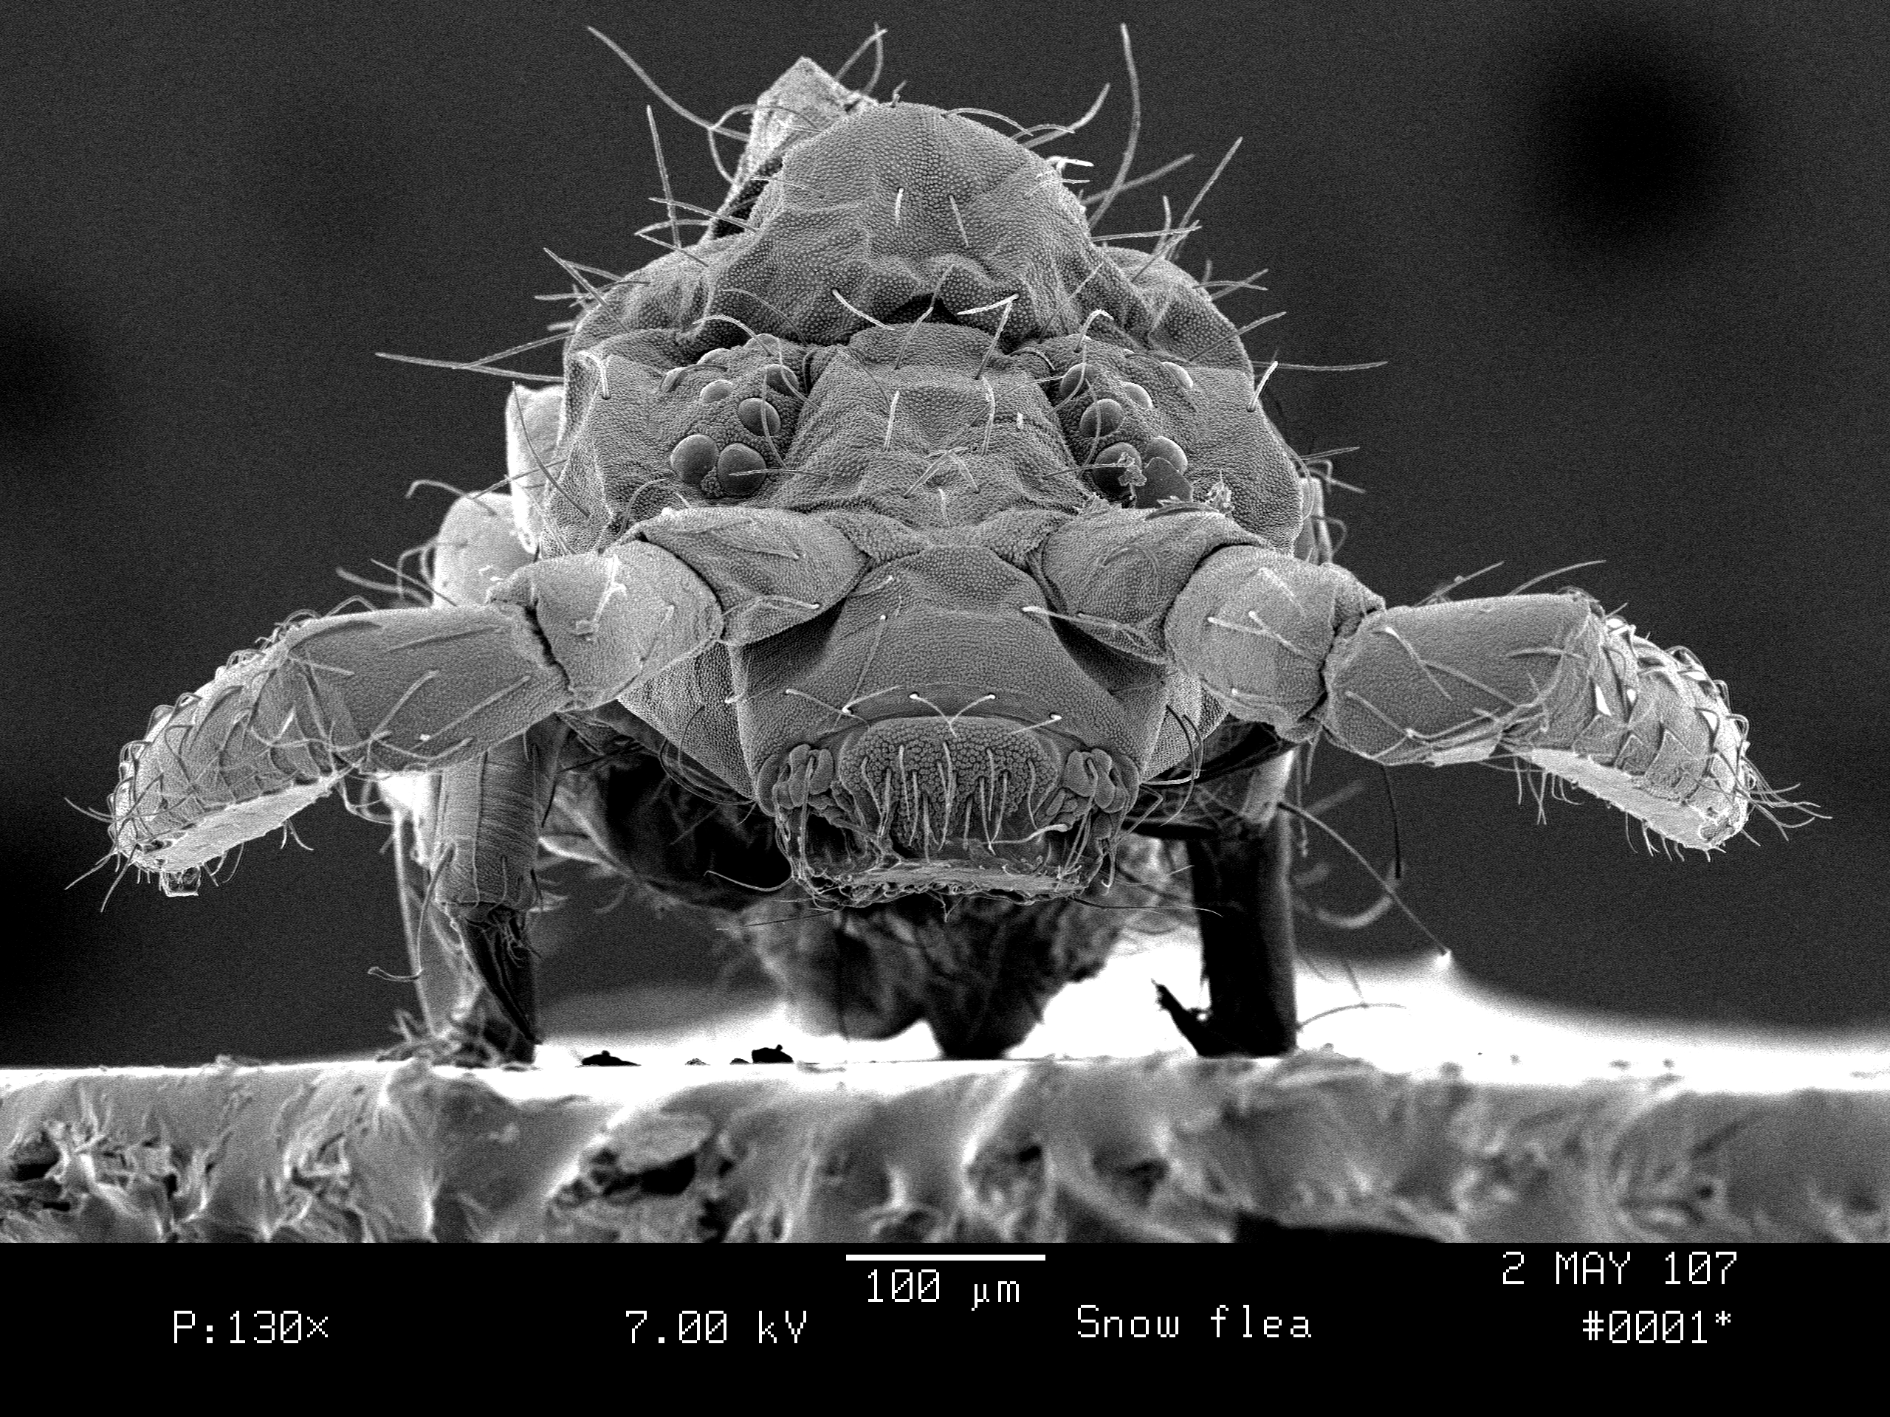
The Big Problem for Maples
Extirpation by 2100 in the USA.
Also birch, quaking aspen, hemlock.
And their ecosystems.

Slide 6
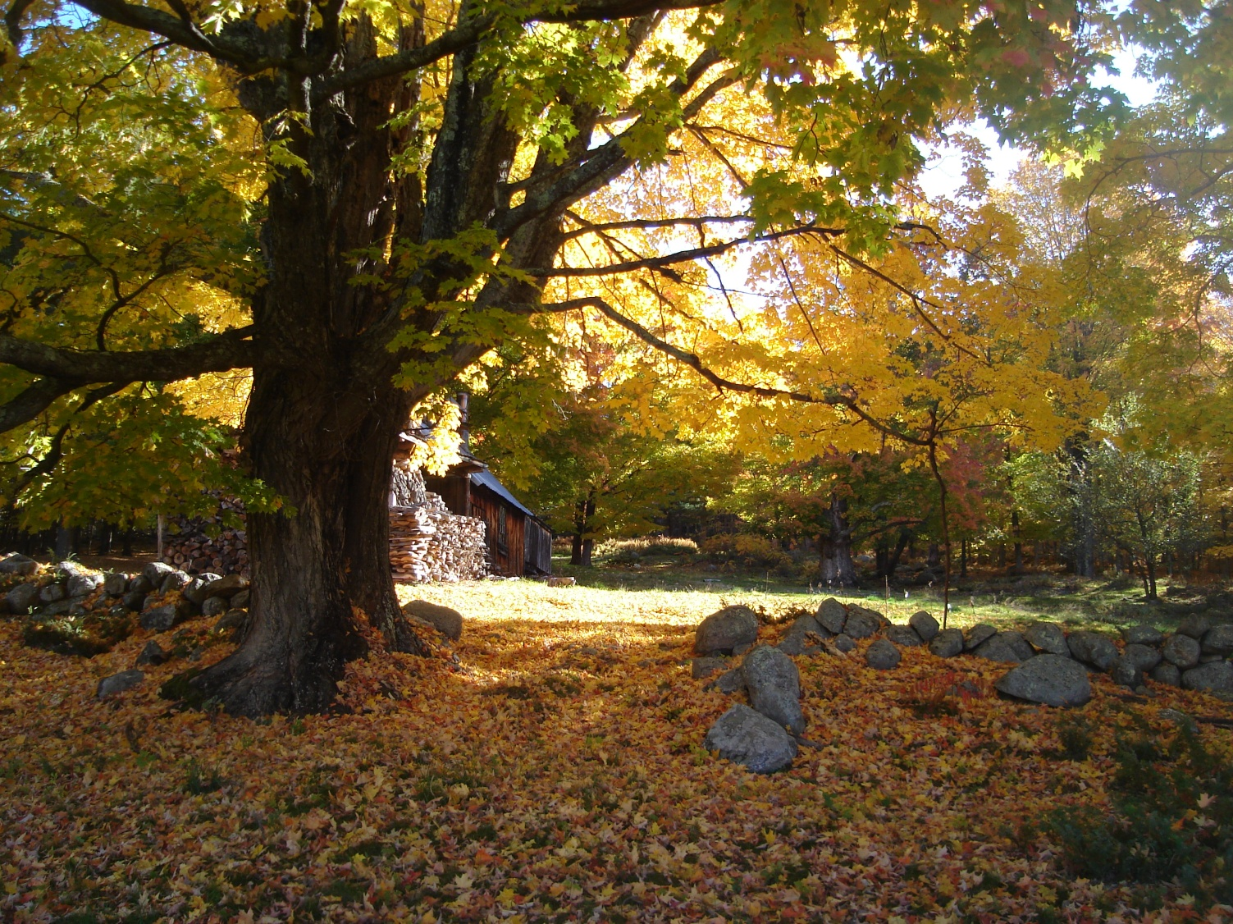
Does Forest Watch Have A New Task?
Observing
Climate
Change

Slide 7
Latitudinal Change

Slide 8
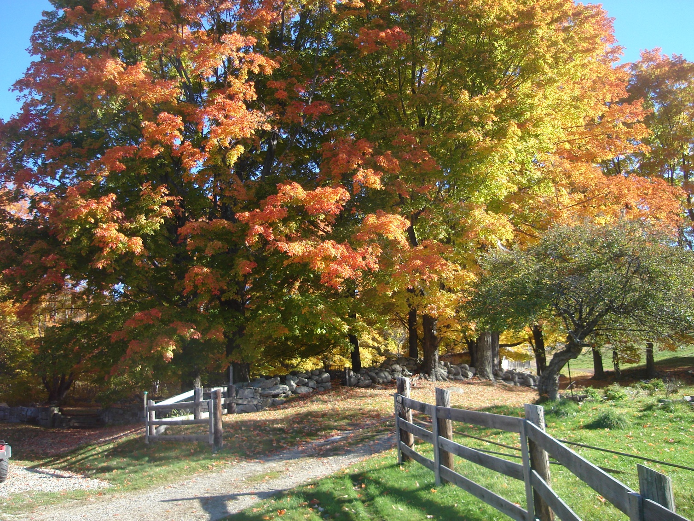
Phenology
Changing Seasons
Bud Break
Leaf Fall

Slide 9
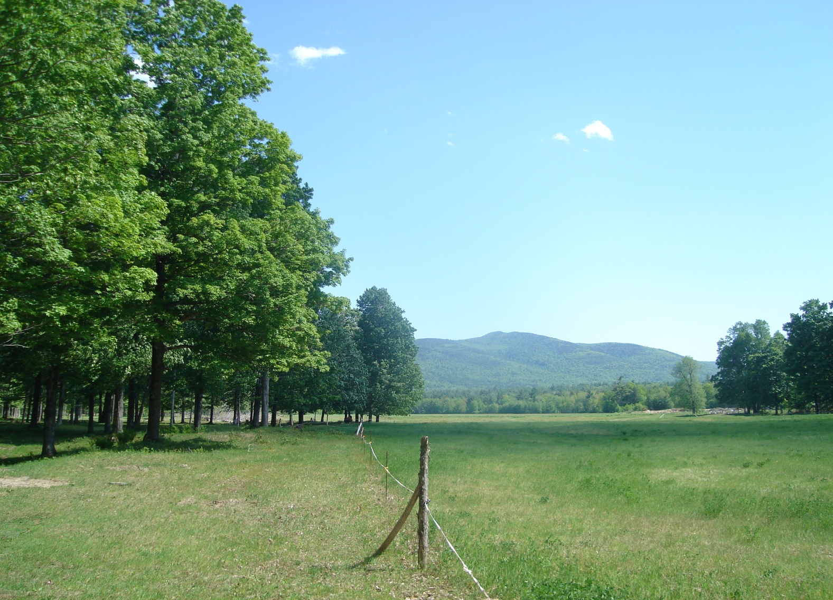
Bringing Global Perspective Home
Is Climate Change Here?
Leaf Health
Sap flow
Syrup quality

Slide 10
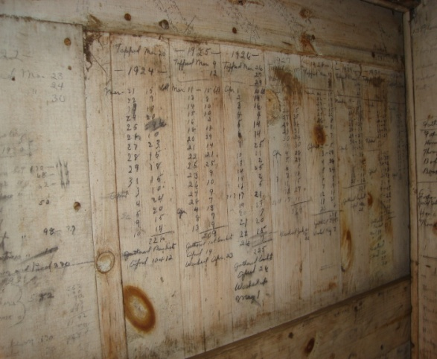
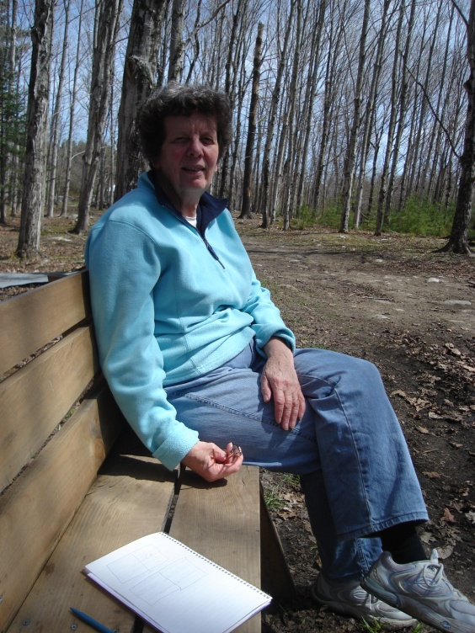
Finding Local Archives
Measuring
Observing
Data analysis
Microscope
Photography
Assay Tools
Communicating

Slide 11
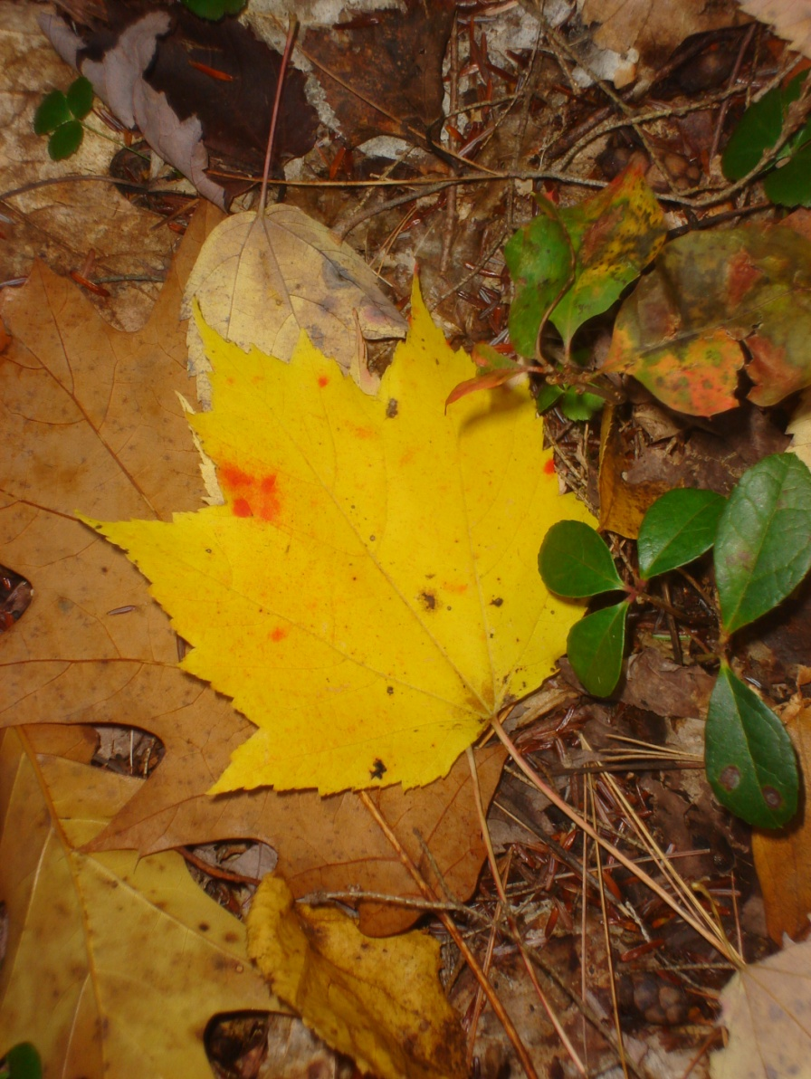
Inductive Thinking, the value of lay field work
Science is generally deductive, building on assumptions and hypotheses. We, in the field, can look and question. And notice the unexpected.

Slide 12
Thank You
Dr. Barrett Rock
Mike Gagnon
Forest Watch
Forest Watch Teachers who are awfully patient. This 7-hour program is now over!!!!!!!

